Slide 1
Digital, Payments &mOperations Development Group (DPODG)
Integration Design
Induction Pack
V0.0.4
July 2017

Slide 2
Welcome
Welcome to the Digital, Payments and Operations Development Group, and to the Integration Design team!
The aim of these slides is to give you a broad introduction to the team, including:
  The Development Centres contained within DPODG
  What the DCs do, and how that fits into Nationwide’s change life-cycle
  What Integration Design does, and how we fit into the DCs’ delivery life-cycle
  The way we do our work, and the deliverables we produce
  Who we are and how we are organised

Slide 3
Contents
Welcome
Introduction to Development Centres within DPODG
  What is a Development Centre? What are the DDC, OMDC, PDC, POWDC and NEMDC? What do DC’s do, and how do Projects engage with them?
Introduction to Integration Design (ID)
  What is Integration Design? How are we organised?
ID Method
  What deliverables do ID produce, and what are they for? What tools do we use?
First Steps for new joiners
  OK, I’m joining the team, what do I need to do now?
To be added…
  Nationwide context (Bus Transformation, Enterprise Development etc) ?
  Deliverable review process
  Summary of FA&D Positions

Slide 4
Introduction to Development Centres and DPODG
What is a Development Centre? What are the DCs in our Group? What do DC’s do, and how do Projects engage with them?

Slide 5
What is a Development Centre?
DCs are ‘software houses’ for application development owning a set of applications that have been grouped by business, technology or process alignment
Each DC will become a centre of expertise on making changes to these applications
DCs deliver all changes to their applications, through a defined release strategy. Each release comprises a set of Work Packages – these can be Small Business Enhancements (SBEs) raised directly from business areas, or Project changes.
DCs have a ‘core’ team size to meet expected demand
  For DDC, NEMDC and OMDC this includes IBM (UK / Global) and Nationwide Technical Practice, and sub-contractors
The core team is augmented with ‘flex’ resource to meet peaks in demand.
DCs are managed by a Head of Development through a ‘Development Group’ that oversees a group of DCs
For a much more detailed explanation, please read the DC Playbook produced by Enterprise Development.

Slide 6
Development Centres in DPODG
Applications Owned
POWDC
The Digital & Channel Development Group (DG) includes 3 Development Centres
There are over 80 applications in DPODG
The full list of applications in each DC is in this SharePoint listing maintained by GOS&A
DPODG maintains a Knowledge Matrix tracking each individual’s expertise in the apps in our scope.
each DC follows a Standard Release Schedule, accessible from their SharePoint home pages.
More later on where to find out more about each of our applications…
POWDC
Document Archive
DDC
(Digital)
Internet Banking
Mobile/Tablet Applications
Originations Apps, e.g.
Discovery
(Current A/C and Credit Card)
PLPOS (Personal Loans)
Branch/Direct Apps, e.g.
Portrait
Transform
OMDC
(Originations & Mediated)
NEMDC
(Nationwide Enterprise Middleware)
Process Orchestration
Enterprise Services
Rules Engine
Business Activity Monitoring

Slide 7

Projects and DCs
Projects are responsible for the early stages of the life-cycle – producing High Level and Detailed Business Requirements and Solution Outlines / High-Level Designs to meet the project’s business objectives
These products identify the changes required and the systems that need to change for the project
The project engages the relevant DCs at various stages to impact assess the changes, before then commissioning them to develop the changes
Each DC then delivers the changes for their applications. The DCs produce Detailed Designs, Code changes and carry out the testing through to System Test and regularly provide status updates delivery back to the project(s).
Once system tested, the project usually takes accountability for System Integration, Performance and User Acceptance testing from other DCs.
  In some cases, DDC/OMDC perform some or all of these later test phases (e.g. when implementing changes that fall entirely within our own applications )
The project then works with the DCs to agree the implementation approach
Development and Test environments are provided by Environment Services
DCDG has defined a set of Input Criteria, setting out for projects what we need their deliverables (HLDs, DBRs etc) to provide for us

Slide 8
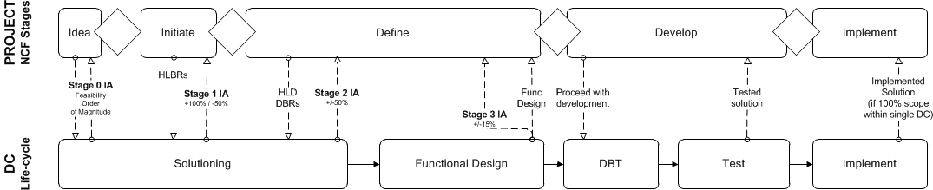
Project Engagement with DDC/OMDC
There are 4 stages to Projects engaging with DDC/OMDC/NEMDC:
Idea Stage
  Project provides outline of scope and solution
  DC (Solutioning team) provides initial high level view of feasibility and Stage 0 Impact Assessment (rough order of magnitude)
Initiate Stage
  Project provides High Level Business Requirements and Outline Solution
  DC (Solutioning team) provides Stage 1 Impact Assessment (+100%/-50% variance)
Define Stage
  Project provides Detailed Business Requirements and High Level Design
  DC provides Stage 2 Impact Assessment (+/-50% variance) (bottom up estimate involving all workstreams, collated by a Release Manager)
  Waterfall: Subject to approval to proceed, DC provides Functional Design Deliverables for own Applications, and Stage 3 Impact Assessment (+/-15% variance)
  Agile: Subject to approval to proceed, DC commences Functional Design and Development for own Applications; Stage 3 Impact Assessment is provided after a certain number of Sprints have completed
Develop Stage
  Project approval to proceed with development based on the Stage 3 IA.
  DC completes development of solution, up to and including System Test
  DC may perform further Test phases and implement the solution where agreed with the Project (e.g. where scope
  is 100% within own applications).
The bulk of work for Integration Design happens here

Slide 9
Introduction to Integration Design
What is Integration Design?
How are we organised?
What are our roles and responsibilities?

Slide 10
Responsibilities of the ID Workstream
Definition and maintenance of functional specifications of DC’s applications, including:
  STPO (Straight through) and LRPO (Long Running) Process Orchestration
  ESB Services
  ODM Rule Engine
Owning DC relationship with business stakeholders (e.g. business representatives owning the requirements, Project Business Analysts) to ensure functionality of DC’s applications delivers against business requirements.
Assessing quality of inputs to ID activities, and ensuring DC quality criteria are met before work commences (e.g. DBRs, HLDs).
Ensuring traceability of ID deliverables upstream to Detailed Business Requirements (DBRs).
Assisting Test Workstream to ensure traceability of ID deliverables downstream to test cases.
Ownership of functional scope of the solution, and identification of scope changes, including changes arising from defects.
Supporting Build and Test in the identification, diagnosis and resolution of defects.
Completion of Stage 2 Impact Assessments and Change Request Impact Assessments for ID Workstream.
Facilitating other Workstream Impact Assessments, by assisting them in understanding the functional impact of change.

Slide 11
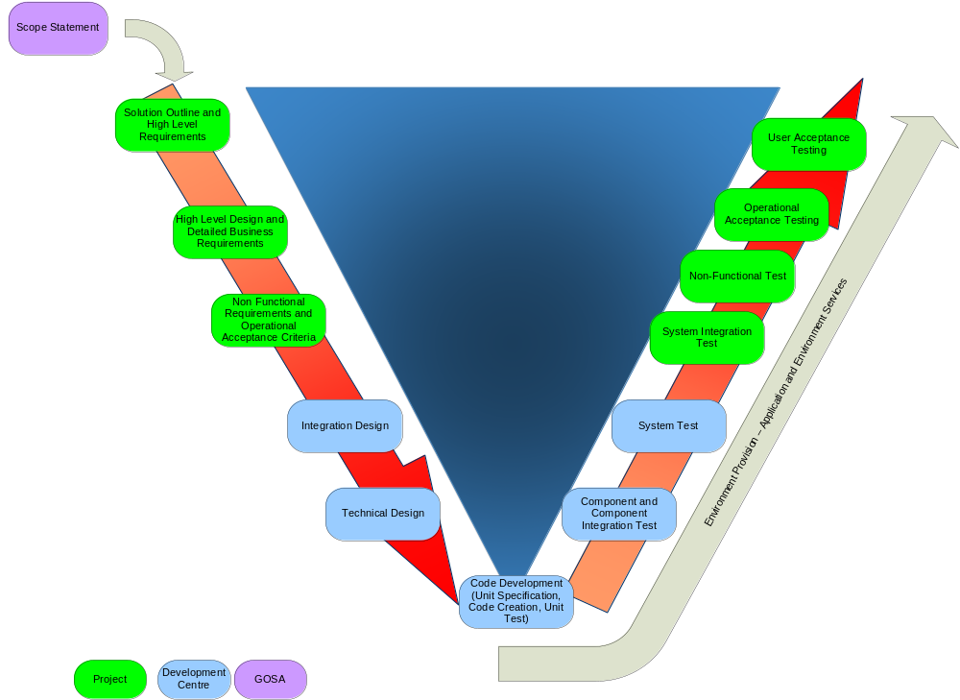
Life-Cycle Overview
DC ‘Value Add’
Services
(SME support to project activities)
DC ‘extended’ test scope
(where agreed with Project)
YOU ARE HERE!
ID produce Functional Specifications
(Prior to this, we also contribute to Stage 2 Impact Assessments)
ID also provide support to DBT and Test (e.g. responding to queries; resolving documentation defects)
DC Delivery

Slide 12
FA&D Team Structure
DC Delivery Manager
Release Manager
Release Manager
Release Manager
ID Workstream
DC IDWorkstream Lead
ID Team Lead
(ID Release Lead)
ID Team Lead
ID Team Lead
ID Team Lead
ID Analyst(s)
ID Analyst(s)
ID Analyst(s)
ID Analyst(s)
Each team works under the leadership of a Release Manager for delivery of the current Release they are working on.
Each ID Team Lead reports to:
  the ID Workstream Lead – re method, deliverables content, quality etc.
  the Release Manager for the release their team is current working on – for reporting progress to plan, escalating delivery issues
There may be multiple ID teams working on a single Release (e.g. changes are needed to multiple channels)
Where a Release includes a combination of multiple ID teams, one of the ID Team Leads may also take responsibility for oversight of the Release as a whole, across the teams, including:
  Owning traceability of ID designs to the Project’s Detailed Business Requirements
  Ensuring consistency of functional solutions across the ID teams.
See the DC Organisation Charts on SharePoint (on the relevant DC home page) for:
  the overall DC organisation
  the current ID team structure and who is working in each team.

Slide 13
Agile in DCDG
Many of the releases in DDC, including Standard Releases for Internet and Mobile Banking, follow an Agile development process.
In a Waterfall process, the functional design is specified in detail and signed off by stake holders before Build work commences.
The NEMDC typically follows a waterfall approach. HLDs and Business Rules are reviewed and approved before being submitted to the DC.
Many agile principles and methods are encouraged within the DC, for example daily stand ups and the use of kanban boards to track progress.

Slide 14
ID Method
What deliverables do ID produce, and what are they for?
What tools do we use?

Slide 15
Design Process
<<Craig to put Design Process>>
<<Craig to put reference to Design Guidelines>>

Slide 16
ID Deliverables – Functional Specification
A functional specification is required for each process or service designed within the NEMDC.
BPM Processes, ESB Services and ODM Rules use different templates due to each spec requiring different information. The templates can be found here.
This template used is based on the functional specification template provided by the Nationwide ‘Technical Practice’
Each section does not have to be completed but you should detail why a section is not application for the functional specification.
An example template for a new service version started from scratch can be found here (InvolvedPartyIdentification V2)

Slide 17
ID Deliverables – Functional Specification
Typically, the functional speciation contains the following sections:
  Use Case Diagram
  Process Specification
  Request and Response message structure (image captured from XML Spy)
  Operation request and response data requirements
  Internal data transformations and mappings to other NEM services / Systems of Records
  Any specific datapower rules which must be completed (see powerpoint on DataPower rules).
  NFR Considerations
  Generated WSDL and XSD files
  Sample XML and Response

Slide 18
Functional Spec Review Process
Peer Review – An internal check. Usually completed with peers and senior members of the team. Be sure to include:
  Solution Engineer
  Solution Architect
Formal Review – Should include a list of reviewers and approvers. Will usually include:
  Test Manager
  Build Lead
  Tech Lead
  HLD Author
  SOR SME
  Business Analyst
NEMDA – See next slide

Slide 19
NEM Design Authority
All design documents in the DC must be approved by the NEMDA before they can be baselined and distributed.
The NEMDC process requires that a Peer and Formal review have been completed before submission.
The NEMDA takes place once per week. This currently happens on a Wednesday.
Your submission should be sent to the NEMDC Tech Lead by the close of business 5 working days before the NEMDA you are targeting. i.e. close of business on Wednesday 5th for the NEMDA taking place on Wednesday 12th.
You should include a summary of the review comments that you have received – see supporting document.

Slide 20
Integration Design (ID) Tools
ID use the following tools for the Design deliverables.
  Rational Software Architect (RSA)
    Use Case Diagrams
    BPMN diagrams
    Sequence Diagrams
    Modelling services and processes
    Sample service WSDL and XSDs
  Note: RSA is also used with RTC to ensure that all design models are maintained under source control.
  Altova XML Spy:
    Diagrams of message structures
    Generating sample XML files for Web services
  CentraSite:
    Required to maintain the traceability of the Design and versioning of Services.
    Designer uploads the most recent version of Design Documents (NEMDA Approved).
  Swagger Editor:
    YAML Specifications – Required for REST Services Design

Slide 21
Where are documents stored?
Functional specs for the NEMDC are stored here.
ESB Services are stored in ‘1. Service Design’
BPM (STPO / LRPO) processes are stored in ‘3. Process Design’
ODM Rules are stored in ‘10. Rules Design’
The other areas contain a number of useful items, specifically ‘5. Core Items’

Slide 22
First Steps for new joiners
OK, I’m joining the team, what do I need to do now?

Slide 23
ID Induction Checklist
Ref | Description | Done?
1 | Ensure ID Workstream Lead has raised an Onboarding form, and requested software access for: Rational Software Architect, Rational Team Concert, Altova XML Spy.
2 | Read the local induction material for your location (PMO can provide)
3 | Agree any travel plans with your Team Lead or Workstream Lead, and start Visa processing if necessary.
4 | Read the DCDG Methods Overview.
5 | Familiarise yourself with examples of all the ID deliverable types. Review examples of the following: BPM Process ESB Service ODM Rule
6 | Access EPM, and make sure you can submit your first timesheet. Talk to your Release Manager or Team Lead to get work items added to your timesheet.
7 | Ensure you have XML Spy installed. If you are an IBMer and have a secondary laptop, you can download a free trial whilst you are awaiting this program to be installed.
8 | Ensure you have RTC installed. Please note you should have the 64 bit version. The package name required is IBM Rational Suite Rational Software Architect 9.1 64Bit P1.0. The ID workstream lead should have requested this specific version. (See supporting documentation).
Ref | Description | Done?
9 | Setup RTC to ensure you can connect to the RTC repository (see supporting documentation).
10 | Install NEM tools plugin for RSA (see supporting documentation)
11 | Install ‘IFW Plugin’ for RSA – see supporting documentation
12 | Set your workspace preferences – see supporting screenshot
13 | Set your calendar visibility on Outlook. To do this Go to your Outlook Calendar tab, and locate your calendar in the left hand pain (under “My Calendars”). Right click and select “Properties...”. Select the “Permissions” tab. Select the “Default” entry in the list and change the “Permission Level” to “Reviewer”.
14 | If you park at Wakefield House, submit your car registration details to the facilities staff. Send an email to the WH Security Supervisor: Kevin Stubbings (Kevin.Stubbings@nationwide.co.uk ) supplying your Car Registration, your name, employee number and a valid contact number.
15 | Discuss with team lead any planned vacation. Update the holiday tracker on SharePoint to log any planned vacation.

Slide 24
Processes - Links
NEMDC SharePoint - (includes holiday calendar) | Book Meeting Room (Condeco Tool)
NBS BYOD Manager – For NBS Wireless | NBS CoE (Includes link to documentation and production systems of CentraSite and RTC).
IT HUB – Software Installation Request (Service Now Tool) | NEM Glossary (explains some of the acronyms, there are lots…)

Slide 25
Integration Design - Links
Reference Library - Design
SO Design
SO 1 Home Page | NEM Core HLD
SO 2 Home Page | NBS SOA Modelling Guidance v1.0
Data Analysis (BOM Mapping – Deliverables) | CHASE Process Models (OPM2)
TMS Tables Data Team Folders | BPS For Standard Tooling – Must for IFW Concepts
NEM Patterns | NEM Versioning Policy – Refer to latest version
NEM Error Codes – MUST for every Design | NEM Versioning Procedure Guidance – Refer to latest version
Transaction Status | Functional Design Templates
NEM Best Practices | Functional Design Deliverables
Business Rule – DMN 1.1Standard | Direct Design
RSA – Configuration
01. Installing RSA v9.1 OR Installing RSAD 961 With RTC 407 | 02. RTC Setup 02.A -> RTC Best Practices
03. IFW Plug-in Installation 04. UML to WSDL Transformatino Extension | Increase Heap size - RSA
Synching Workstreams – RSA – RTC | Generate SOAP Binding – RSA – Required for Service Modeling

Slide 26
Integration Design - Links
Open Banking
YAML Spec - External Link | YAML Introduction - External Link
Writing Swagger - External Link | YAML Format - External Link
IBM RESTful web service basics - External Link | HTTP Status Codes - External Link
Service Design –Deck – Lunch-n-Learn
Every Day Banking
Design Link

Slide 27
Design Tools Installable Path
\\dvmsdnw01\NEMDC\Software
\\DVNEMFSHW01\NeMDC\Software\Installers - RTC -CLM\4.0.7 - This is required to integrate RSA with RTC. One should install it through Help -> Install New Software, after opening RSA in your new workspace.
Raise a new request for Altova XML Spy tool. After request is finished (with the installation of this tool), get the license from your Design Lead or PMO Team.
  Link to IT HUB. Click on Order IT and follow the steps.
Installable Path for RSA 9.6.1
  \\DVNSLCOEW01\NSL_CoE_Public\RSAD961Setup
  Follow the instructions as mentioned in the document -> Installing RSAD 961 With RTC 407.docx kept in the same location and on sharepoint link too.

Slide 28
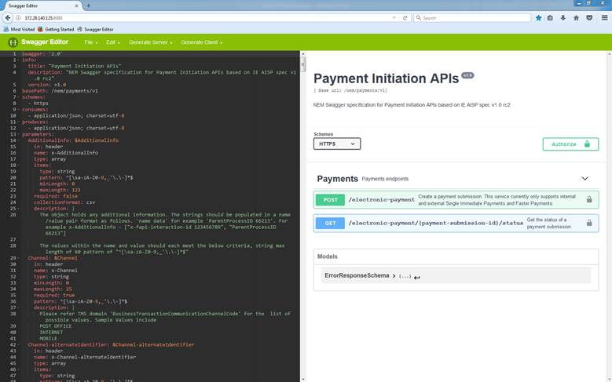
Open Banking - Tooling
To get this tooling setup please follow these instructions from Andrew White to access the local Swagger Editor.
  Create a “FirefoxPortable” folder within “My Documents”.
  Go to this link -----> \\dvnemdpw01\edrive\FireFox
  Run and install FirefoxPortable_54.0_English.paf to the “FirefoxPortable” folder you created earlier.
  Once installed, go to the following URL within Firefox -----> http://172.28.140.125:8080/
  This may take a minute or two to load, but once loaded you should be able to access and see something like the following screenshot.

Slide 29
Useful Contacts for review
Name | Email | Role | Reviewer Type
Ruud Schoonderwoerd | Ruud.Schoonderwoerd@nationwide.co.uk | Solution Architect | Peer Review
Graham Laundon | Graham.Laundon@nationwide.co.uk | EM1 Solution Engineer | Peer Review
Stephen Rea | Stephen.Rea@nationwide.co.uk | EM2 Solution Engineer | Peer Review
Denis Lewis | Denis.Lewis@nationwide.co.uk | NEMDC Tech Lead | Formal Review / NEMDA
Patrick Herring | Patrick.Herring@nationwide.co.uk | Technical Practice | Peer Review / Formal Review
Rahulkumar Dhadke | Rahulkumar.Dhadke@nationwide.co.uk | Workstream Test Lead | Formal Review
Dider Nohlmans | Didier.Nohlmans@nationwide.co.uk | Workstream Build Lead | Formal Review
Jonathon Carr | Jonathon.Carr@nationwide.co.uk | ODM SME | Peer Review (only for ODM Rules).

Slide 30
Version History
Version | Date | Author | Change
0.1 |  |  | Initial baseline from DPODG
0.0.2 | 06/02/2017 | David Garvie, Emma Cotterill | First Draft updated to include NEMDC items
0.0.3 |  | Emma Cotterill
0.0.4 |  | Jasper Thorburn | Added useful links
0.0.5 | 17/01/2018 | Pramod Dutt Pant | Updated Deck with more details on Design Process/Links

